Slide 1
Fat Cows

Slide 2
Mortality
Fat cow syndrome is a disease of periparturient cows characterized by extreme obesity and an increased number of periparturient diseases. The etiology of fat cow syndrome is excessive consumption of an unbalanced diet. The manifestations of fat cow syndrome are due primarily to the extensive fat metabolism of the liver.

Slide 3
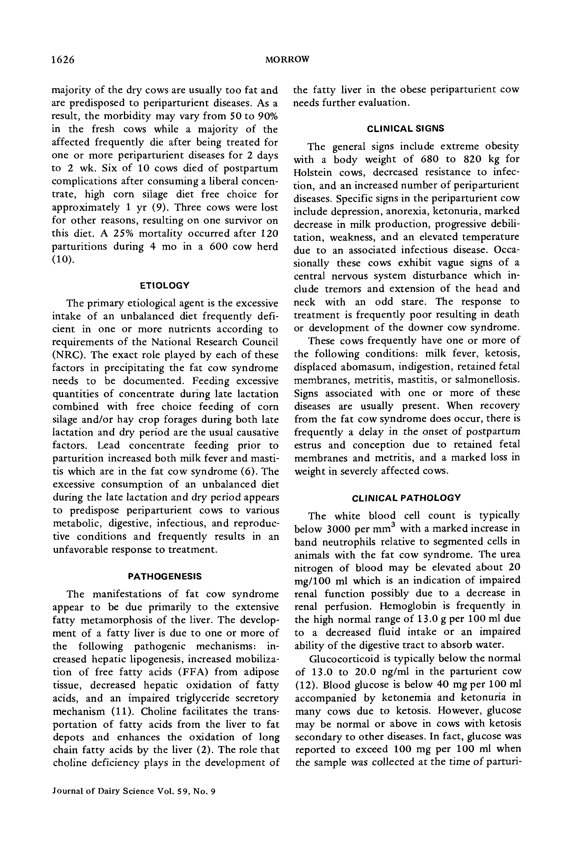

Slide 4
Symposia: Stress and Health of the Dairy Cow
The fat cow syndrome is a periparturient condition in which the cow is grossly obese and has a fatty liver. The syndrome is characterized by the presence of periparturient diseases which are more severe than in normal cows.

Slide 5
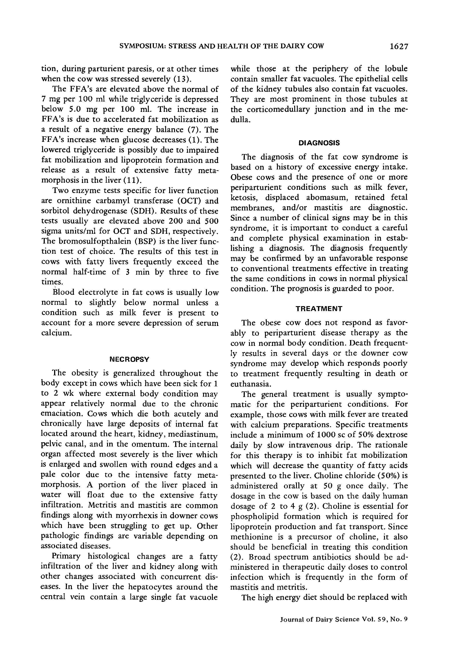

Slide 6
Fat Cow Syndrome
The fat cow syndrome is a metabolic disorder in dairy cows that occurs during the dry period. It is characterized by anorexia, hyperglycemia, and hyperlipidemia. The syndrome can be prevented by proper feed management.

Slide 7
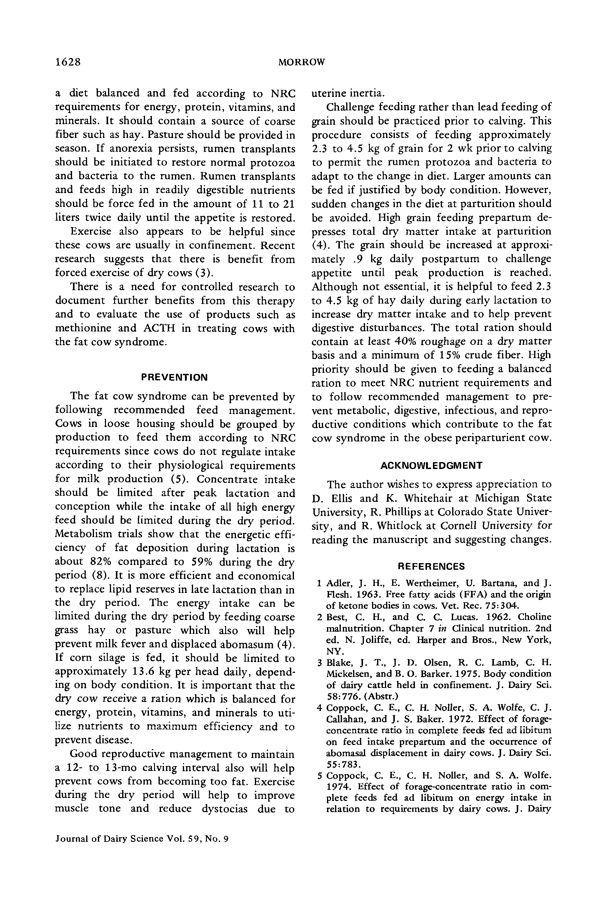

Slide 8
Symposium: Stress and Health of the Dairy Cow
The effect of stress on the health and productivity of dairy cows is discussed. The various types of stress and their sources are described.

